Slide 1




Energix
Smart energy platform

Slide 2
Energix
Team members
Ahmed Alaa
Belal Rezk
Malak Ahmed
Sohaip osama
Youssef Mohamed

Slide 3
Energix
Problem
One of the most important problems that affects the budget is the lighting that is on in the warehouses 24 hours a day, and this increases the financial cost for the hypermarket or any company that has warehouses, and now Suhaib will tell us the solution to it.

Slide 4
Energix
Solution
  When there is no movement, the light is reduced to 20%. When movement is detected in a specific area, the lighting in that area is turned on at 100% while the lighting in the rest of the warehouse is reduced.
  The system also reduces the lighting according to the intensity of sunlight. In the event of an emergency, such as a fire, the warehouse lights are turned on for safety reasons. Now, Bilal will explain the software prototype.

Slide 5
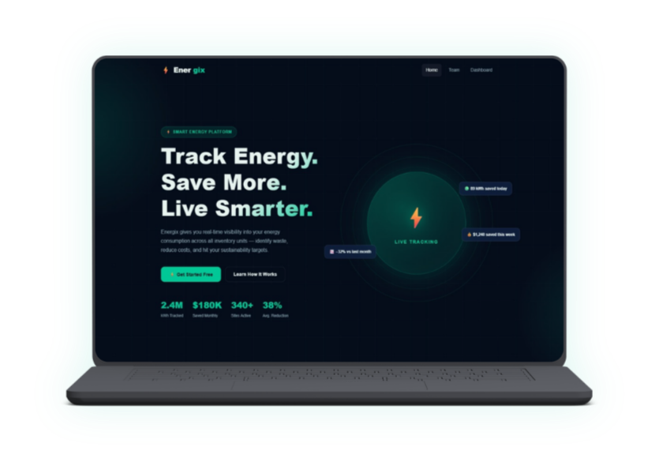

Energix
Software Solution
Extract
pdf
Dashboard

Slide 6
Energix
Value Propositions
Executable Reports
Cost Efficiency
Extends Bulb Lifespan

Slide 7
Thank you

